Slide 1
MongoDB
MongoDB Database | Mongo Shell | Inserting Documents | Finding Documents | Updating Documents | Deleting Documents
Notes:
Welcome to our lecture on Mongo DB. In this lecture we will go through what is mongo DB, mongo DB shell, how to insert documents, find documents, update documents and delete documents. Let’s start the video lecture.

Slide 2

MongoDB Document Database
MongoDB is a popular NoSQL database for Node.js, storing data as documents in collections.
Documents are field/value pairs, similar to JSON, stored in collections.
BSON (Binary JSON) is MongoDB’s internal format, supporting various data types.
Size Limit: A BSON document can be up to 16 MB.
Notes:
In this section, we introduce a widely used database designed for handling structured yet flexible data. It stores information as organized entries, resembling structured text, within categorized groups. The format used internally allows efficient data processing with support for multiple data types. Additionally, there is a size limitation for each entry to ensure optimal performance.

Slide 3
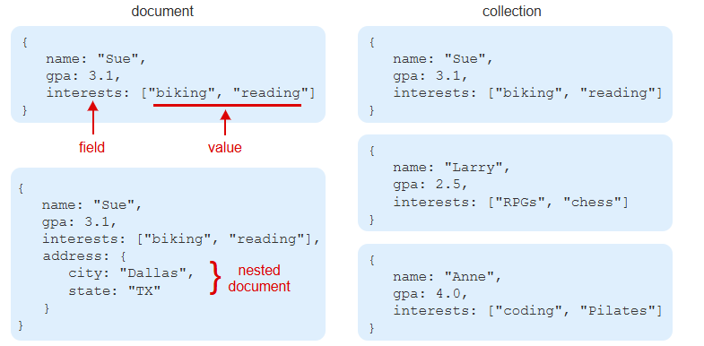
Example
Notes:
This example illustrates how data is structured in a document-based database. Each entry consists of fields and values, where values can be simple types like numbers and text or more complex types like lists. A collection is a group of these structured entries. Some entries can also contain nested structures, allowing for a more flexible representation of related data within a single record.

Slide 4
MongoDB Shell
MongoDB Shell is a command-line tool for managing MongoDB.
mongosh command starts the MongoDB Shell.
It allows creating/deleting documents, querying, and managing users.
Notes:
The command-line tool provides an interactive way to manage the database. It allows users to connect to the system, interact with collections, and perform operations like creating, updating, or deleting records. This tool is useful for running queries and administering the database efficiently. Users can execute commands to manage data, configure settings, and monitor performance.

Slide 5
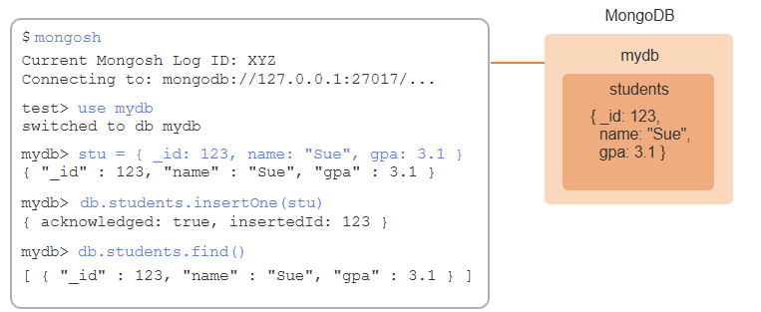
Example
Notes:
This example demonstrates how to interact with the database using the command-line tool. It starts by connecting to the system and selecting a specific database. A new record is created and added to a collection, where it is stored. Finally, a query retrieves the stored data, confirming that the information has been successfully inserted and is now part of the database.

Slide 6
Inserting Documents
insertOne() inserts a single document into a collection.
insertMany() inserts multiple documents at once.
Example: Sue is added to students, then three more students are inserted.
Notes:
In a database, adding data can be done individually or in bulk. A single record is added to a collection, making it easy to store one entry at a time. For efficiency, multiple records can be added at once, saving time when working with large datasets. For example, one student is stored first, followed by a batch of additional students being inserted together.

Slide 7
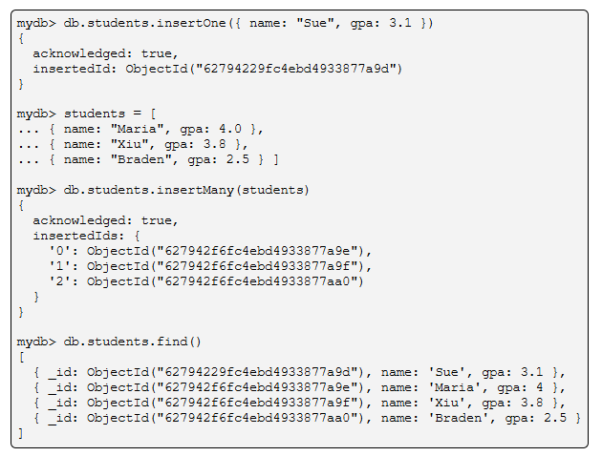
Example
Notes:
Here, a single record is added to the collection, confirming successful storage with an identifier. Next, multiple records are inserted at once, improving efficiency when handling bulk data. Finally, retrieving all records shows the stored entries, ensuring they were added correctly. This method is useful for managing structured data in an organized way.

Slide 8
Finding Documents
find() returns all documents or those matching a query.
findOne() returns the first matching document.
Both return null if no documents match.
Notes:
When searching for records, a method retrieves all matching results, while another returns only the first match. If no match is found, both methods return an empty value. This allows for flexible data retrieval, whether needing a single entry or a full dataset. Using the right method ensures efficient querying based on specific needs.

Slide 9
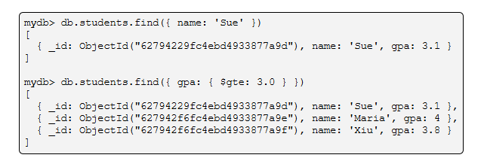
Example
Notes:
Now that we understand how queries work, let's see them in action. When retrieving records, we can either look for an exact match or apply conditions to filter results dynamically. This helps refine searches, whether for a single entry or a set of matching data. Next, we will explore how filtering works with different conditions to optimize data retrieval.

Slide 10
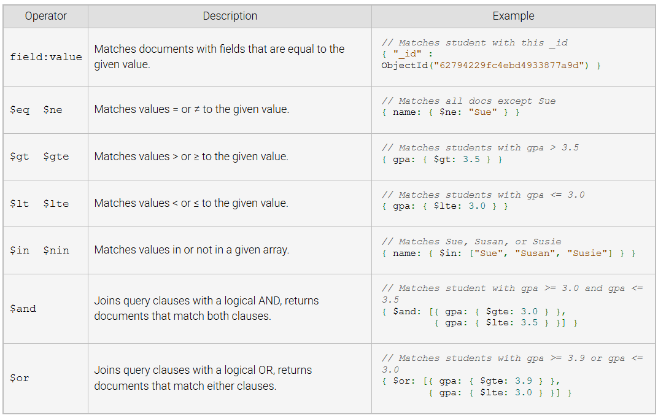
Common MongoDB Query Operators
Notes:
When working with databases, using operators helps refine searches and filter results effectively. These allow us to match exact values, compare numbers, check for inclusion in lists, and even combine conditions with logical connectors. By using different options, we can retrieve specific records efficiently. Now, let’s look at how these operators work in practice.

Slide 11
Updating Documents
updateOne() modifies a single document in a collection.
updateMany() modifies multiple documents.
Requires a query (to find documents) and an update (modification).
Returns matchedCount (matched docs) and modifiedCount (updated docs).
Notes:
Updating records in a database allows modifications to existing data without inserting new entries. A single record can be modified or multiple records can be updated at once. This process requires a condition to locate the relevant data and a modification to apply changes. The system provides feedback on how many records were found and how many were actually modified. Let’s see how this works.

Slide 12
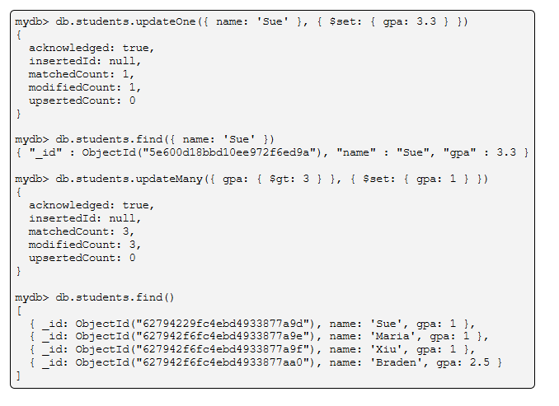
Example
Notes:
Here is an example of modifying records in a database. A single record is updated first by changing a specific field value for a matching entry. Next, multiple records are updated simultaneously based on a condition. The system confirms how many records were located and successfully modified. This process ensures efficient data updates without inserting new entries.

Slide 13
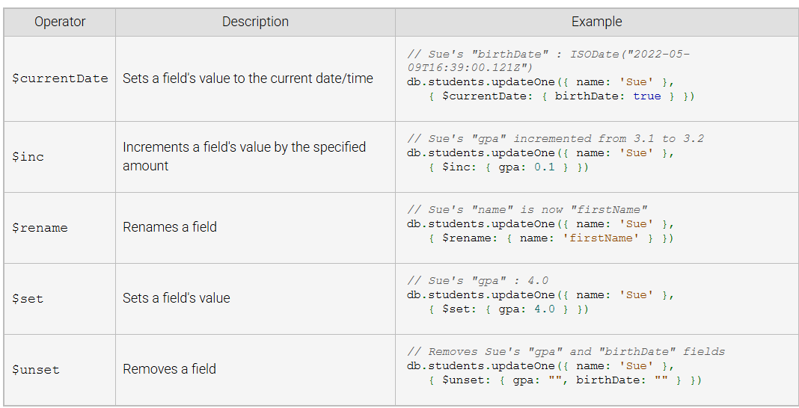
Common MongoDB Update Queries
Notes:
When modifying records in a database, various update operations can be used. A field can be set to the current date and time, incremented by a specific value, renamed, or updated with a new value. Additionally, unnecessary fields can be removed. These operations help in managing data efficiently, ensuring records remain up to date and relevant.

Slide 14
Deleting Documents
deleteOne() deletes a single document.
deleteMany() deletes multiple documents.
Returns deletedCount, showing the number of deleted documents.
Notes:
When managing data, records can be removed individually or in bulk. A single record can be targeted for deletion, while multiple matching records can also be removed at once. After deletion, a count is provided to indicate how many records were successfully removed. This process helps maintain a clean and efficient database by eliminating unnecessary or outdated information.

Slide 15
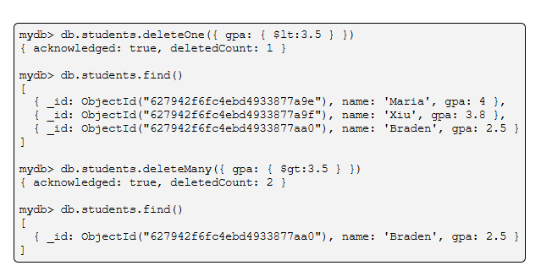
Example
Notes:
This example demonstrates how to remove records from a dataset. A single record is deleted when it meets a specific condition, and the operation confirms the number of records affected. Multiple records can also be removed based on matching criteria, providing flexibility in data management. The dataset is then updated to reflect the changes.

